Slide 1






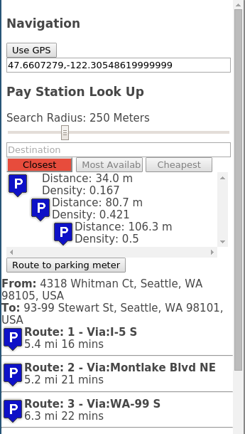
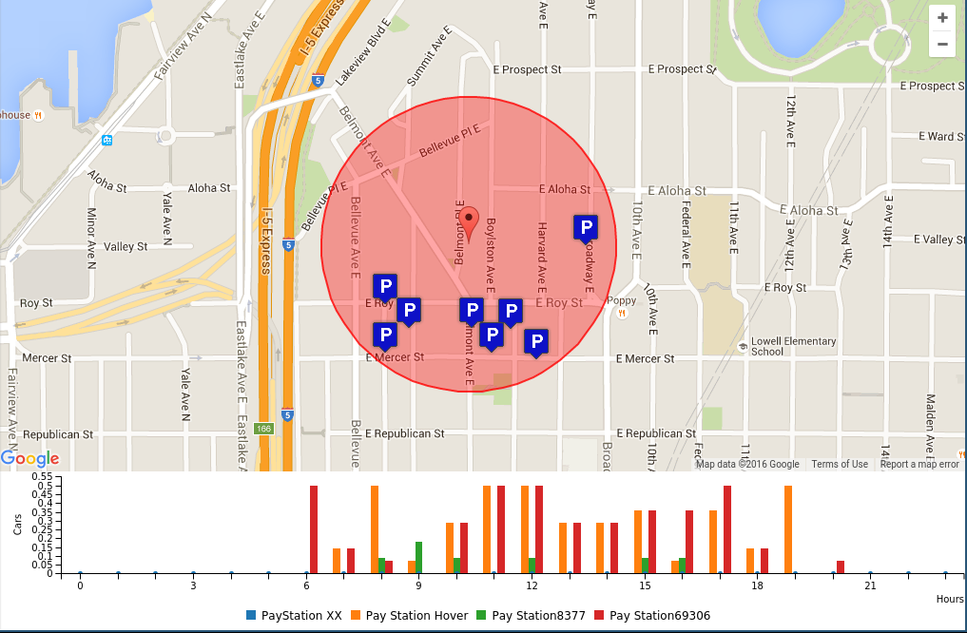
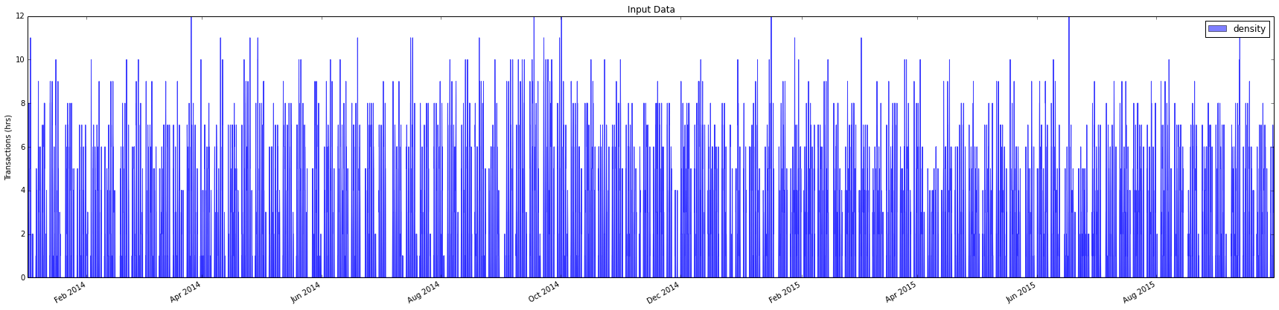
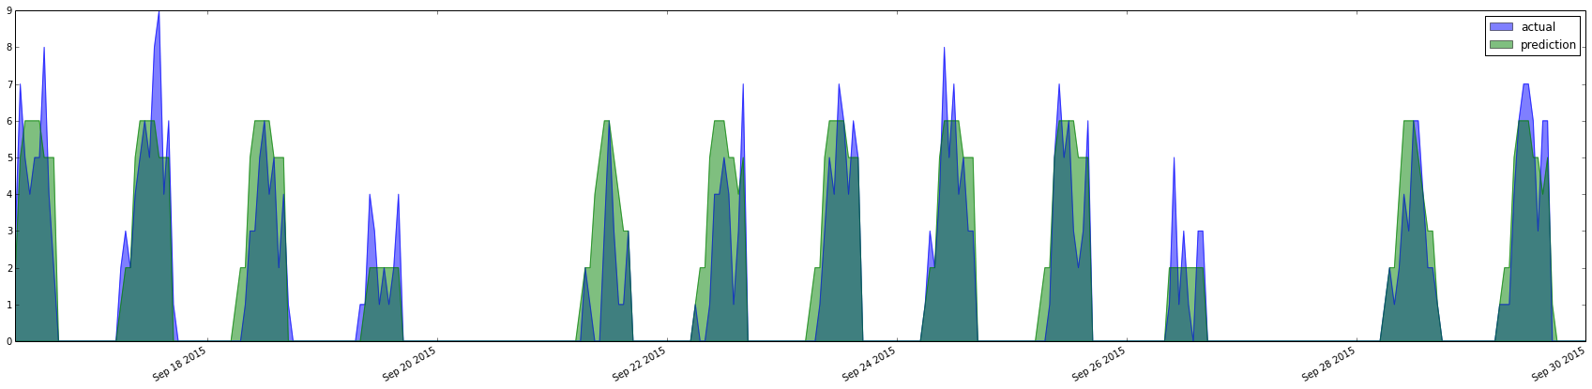
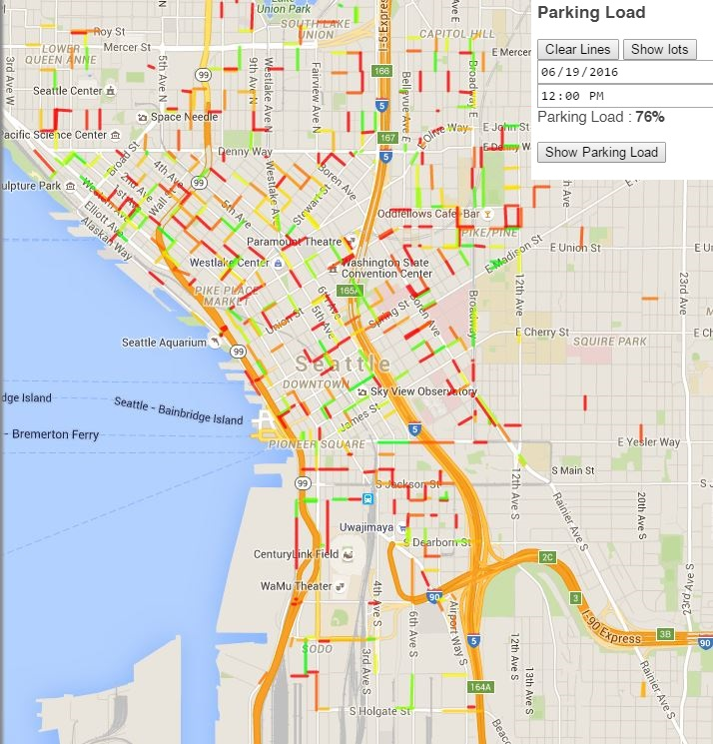
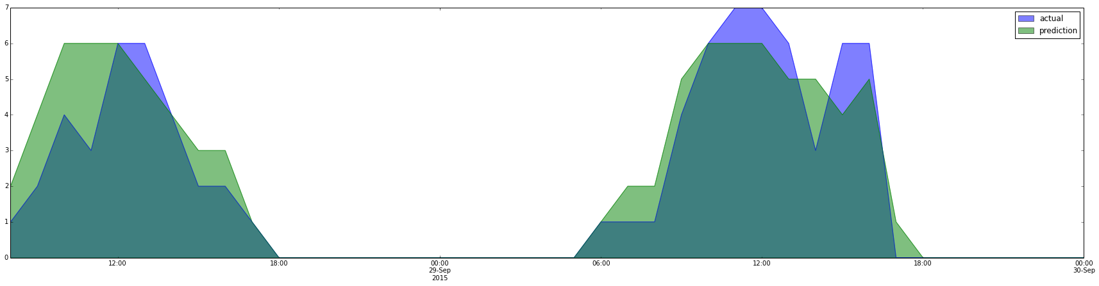
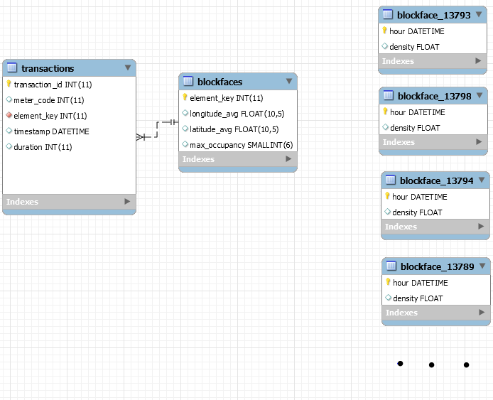
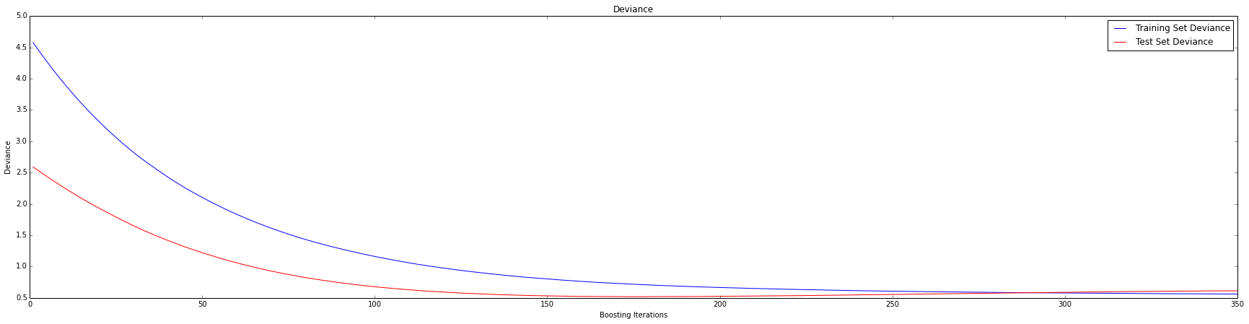
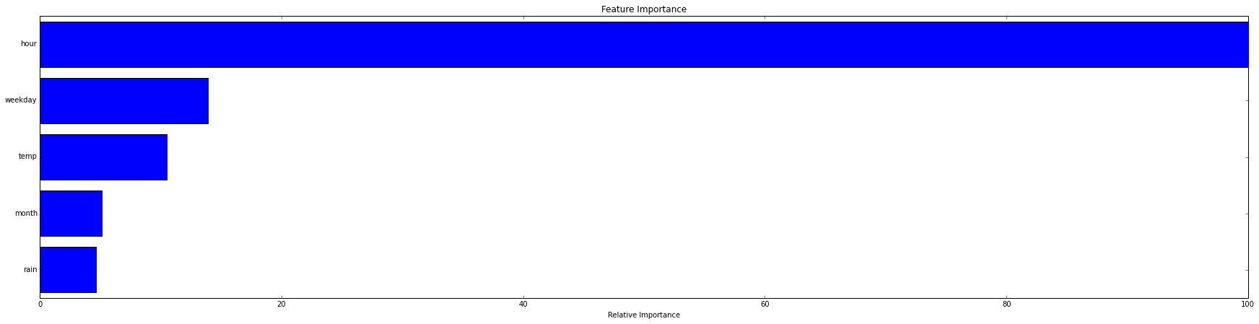
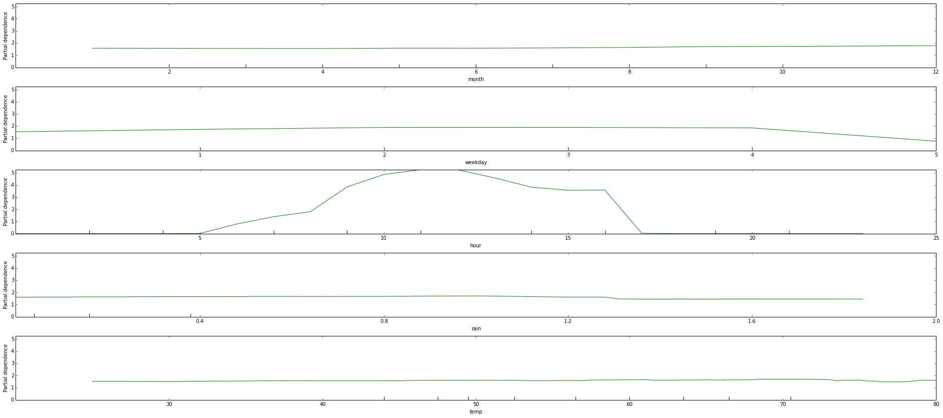
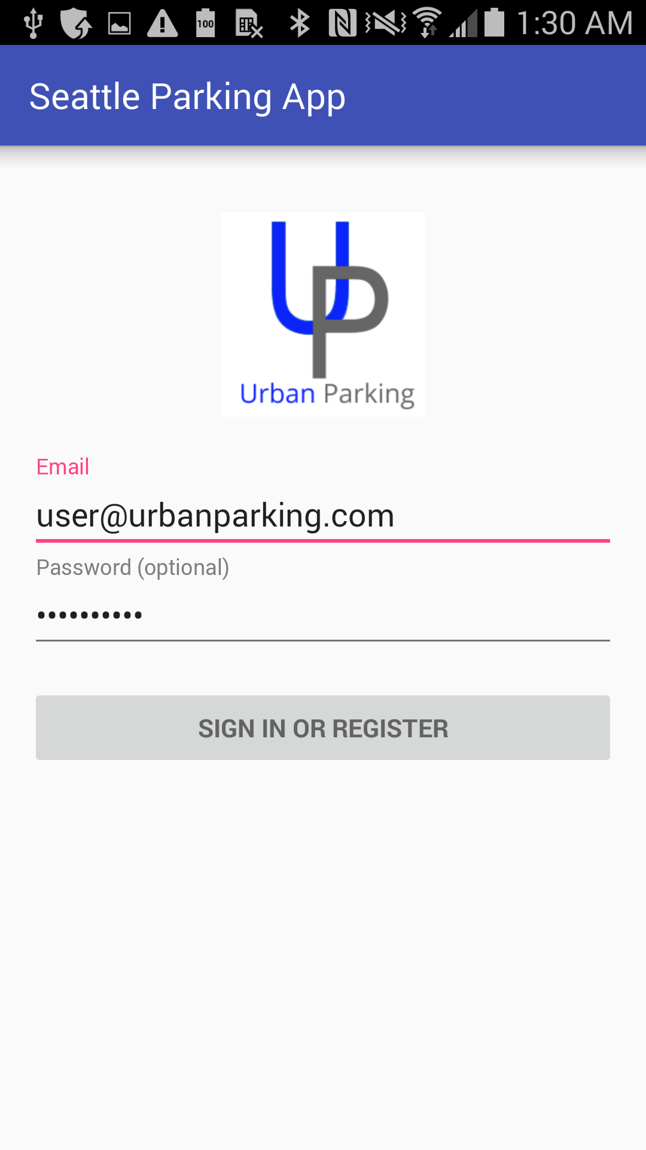
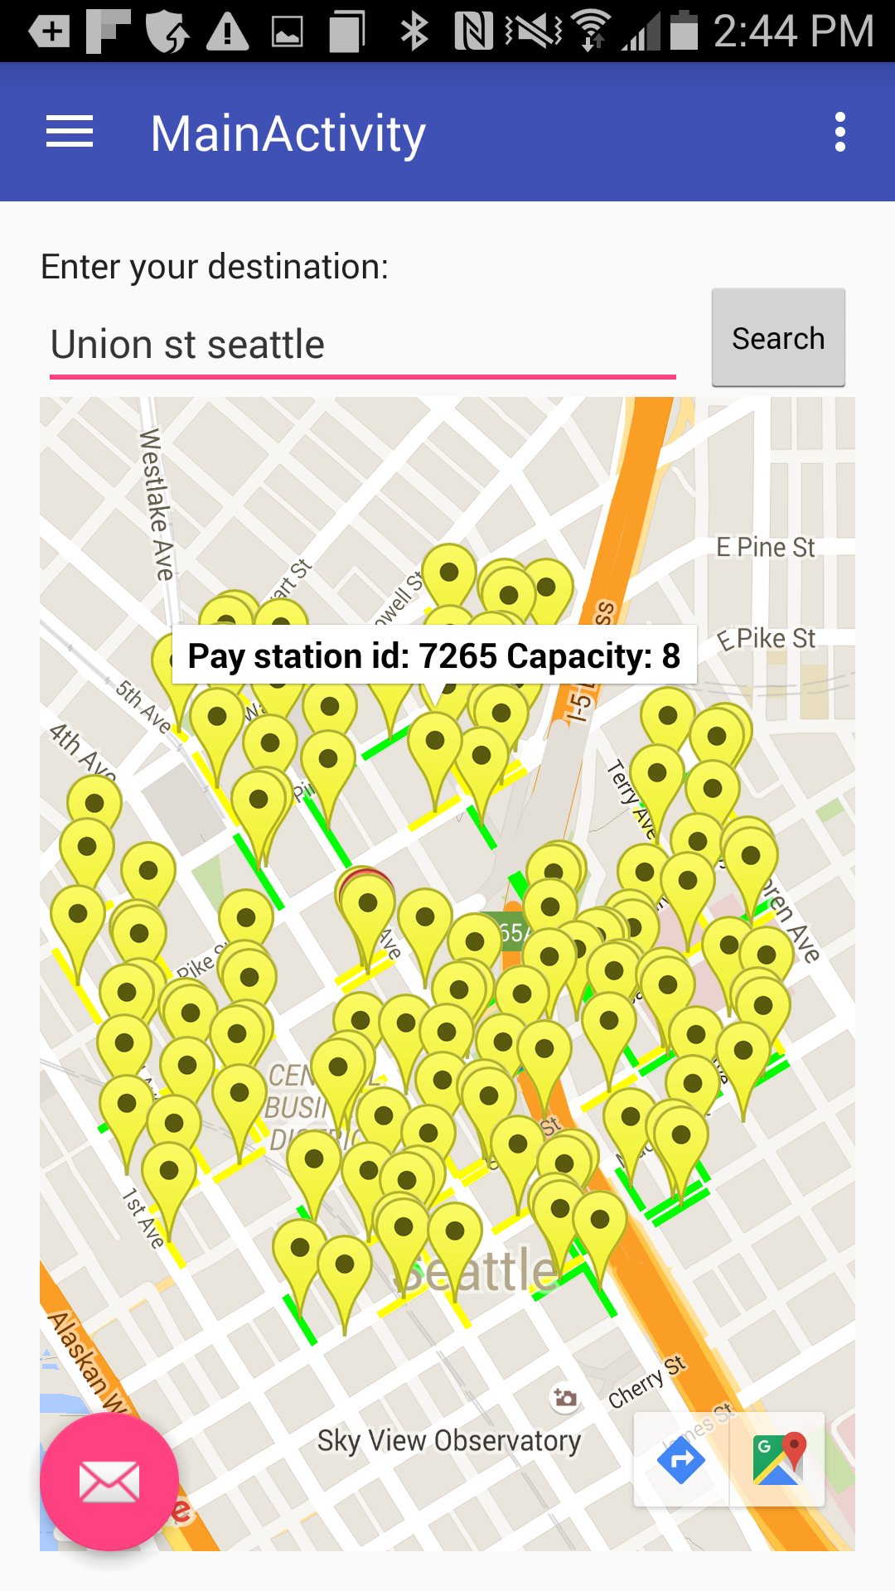
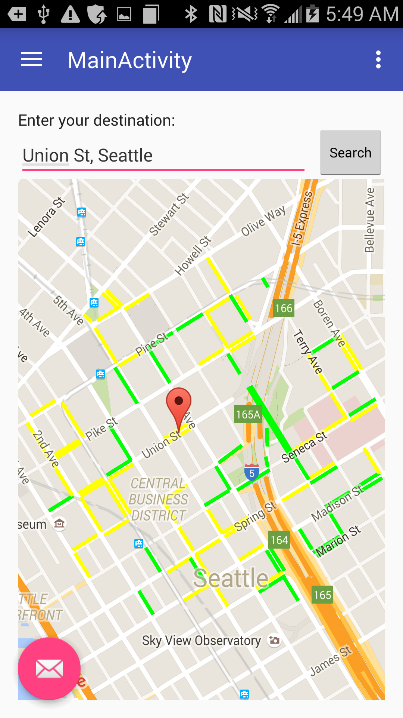
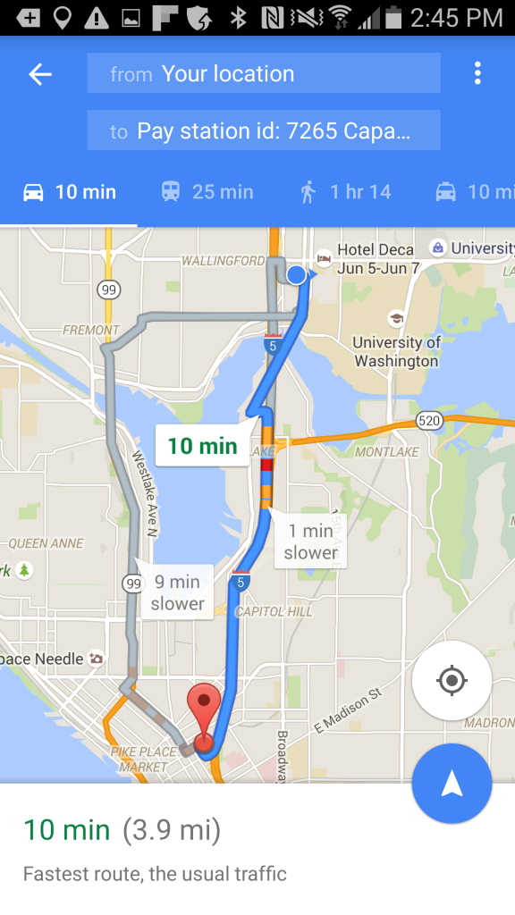







Urban Parking App
Jake Garrison, Kyle Lee, Daniel Ng, Jiayu Dong
Baosen Zhang and Lillian Ratliff, UW EE
Mary Catherine Synder, Seattle Department of Transportation
www.urbanparking.xyz
App Description
Web Front End
Prediction Algorithm
What if there was something like google maps that could take you straight to an empty parking spot?
Our technology aims to make parking easier for drivers and reduce urban congestion by keeping cars off the road
We are building a mobile app that predicts regions with open parking based off historical data
A user will be able to input a destination and other options such as a preferred walking distance and a route to the ideal parking location is calculated and displayed.
Routes can prioritize time, parking cost and walking distance so the user gets the ideal directions for their situation
Our solution uses predictive analytics to route users to areas with open parking. This will not only decrease the time the user has to spend driving, it will also alleviate bad city traffic and urban emmissionsz
No one is attempting to solve this problem in the way that we are.
Navigation Menu:
Local parking spot data:
Load data: data for single paystation from 2014 to 2016
Finds route, shows density histogram and closest parking to destination
Histogram with x axis being hourly date and y axis, number of transactions at paystation
Predict: forecast 14 days of parking and overlay on actual data
Prediction based of following features:
Month (1 to 12), Weekday (1 to 7), Hour (0 to 24), Daily Rain (inches), Daily Mean Temp (F)
Gradient Boosting Paramaters:
learning_rate = 0.1, n_estimators = 100, alphas = 0.95, depth = 6, loss = huber
Downtown prediction:
Back End
Prediciton for June 19th 2016, 12:00 PM
Streets are colored based of the prediction density
Colors fade from RED = full to GREEN = empty
The framework is built using Flask and runs on an Amazon EC2 instance using Amazon's Elastic Beanstalk, serving a RESTful API to front end clients. Ultimately, this serves as an intermediary between the database and the front end. Using REST API means that the back end can support any front end client with an HTTP connection.
Raw transaction data, pay station information, analytics generated by the prediction algorithm, and other insights are stored in a MySQL database.
zoomed in on two forecasted days
Database Schema:
analyze results:
14 Day Forcast Error: Mean Square Error = 1.26, R2 = 0.60
Prediction Convergence:
Shows required iterations for convergence, based off learning_rate and n_estimators
Feature Importance:
Shows which features have most prediction impact
Mobile Front End
Feature Dependence:
Shows which values of each feature contribute to parking load
Powered by:

